Slide 1

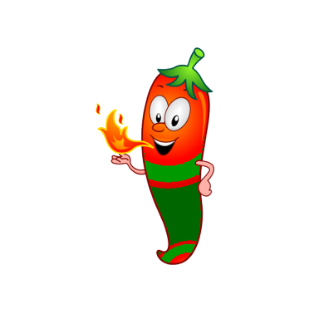
Chili War
created by
Svetoslav Ivanov
Nikolay Shalyavski
Asya Dikova
https://github.com/JavaTeamwork/JavaGamePuf/commits/master

Slide 2
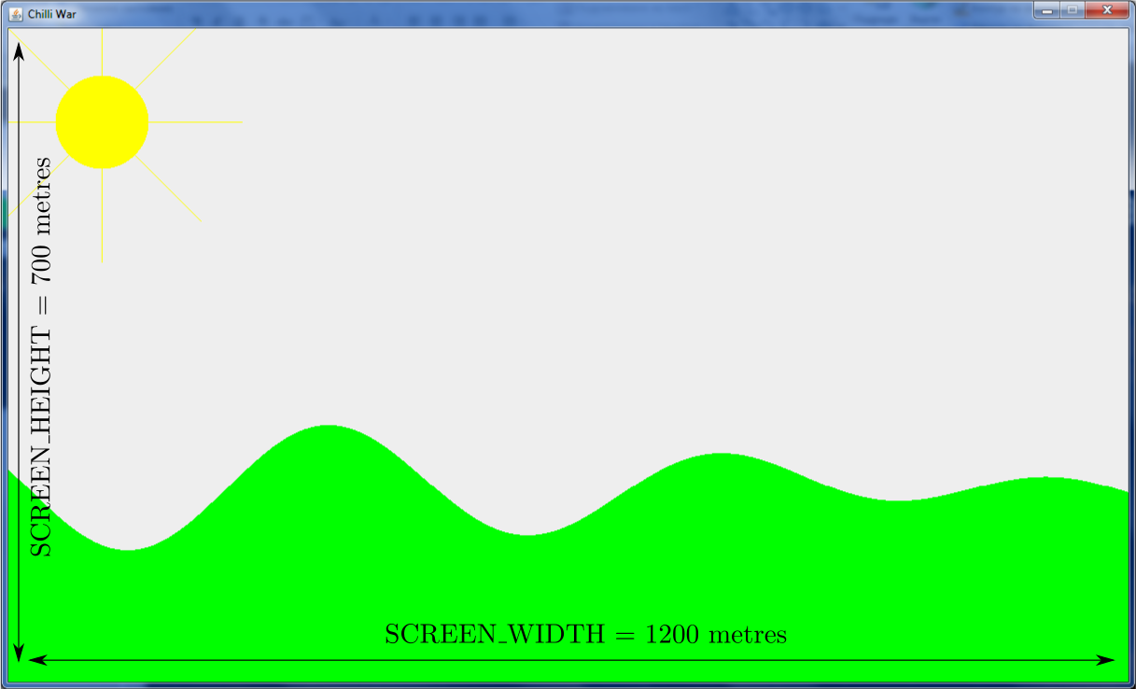
Field size

Slide 3
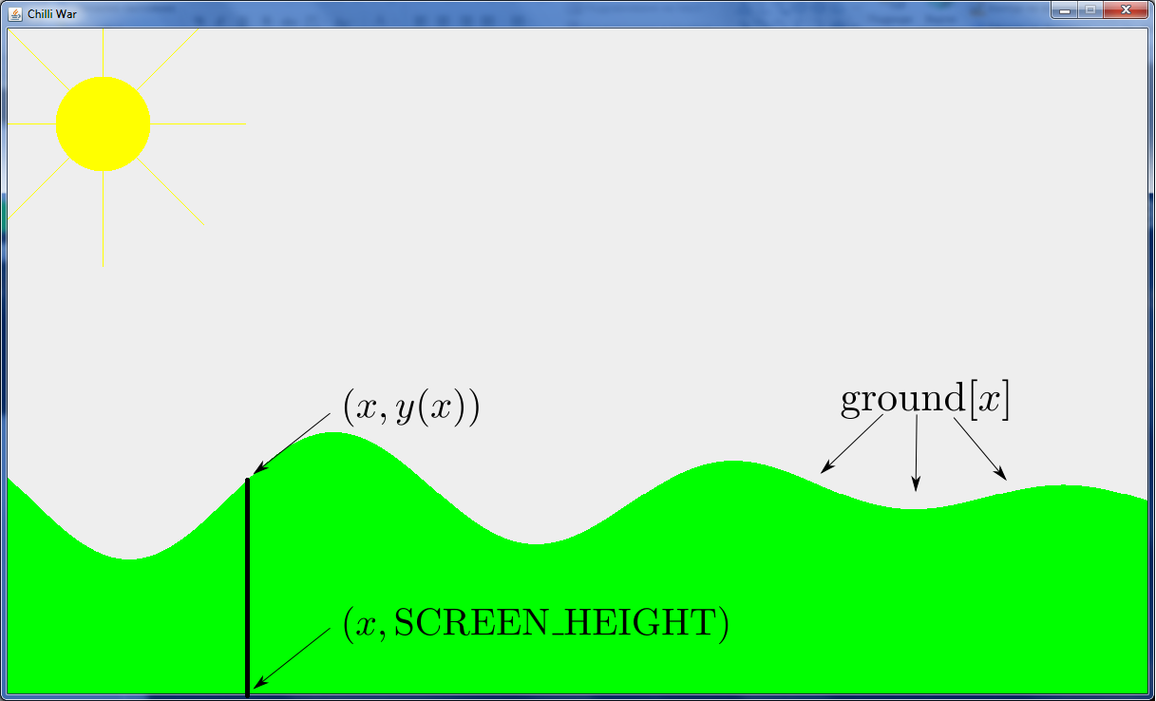
Define the ground

Slide 4
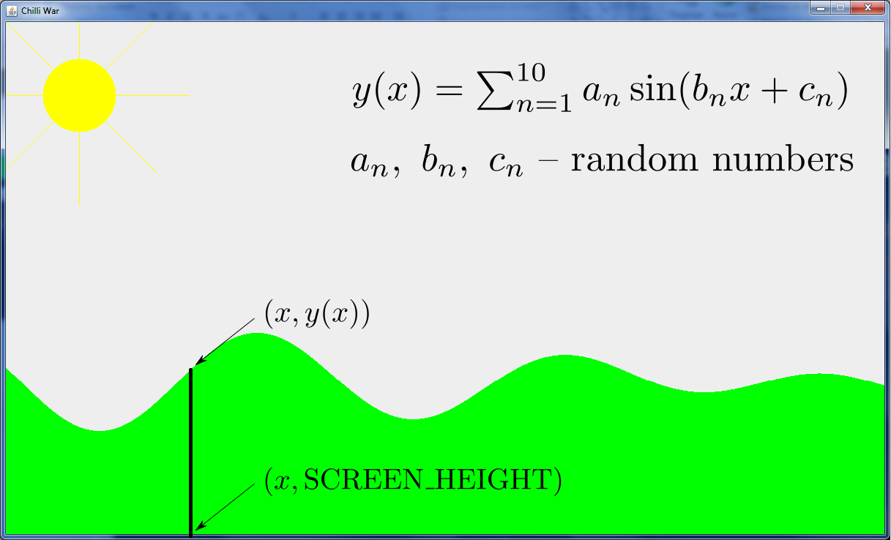
Define the ground 2

Slide 5
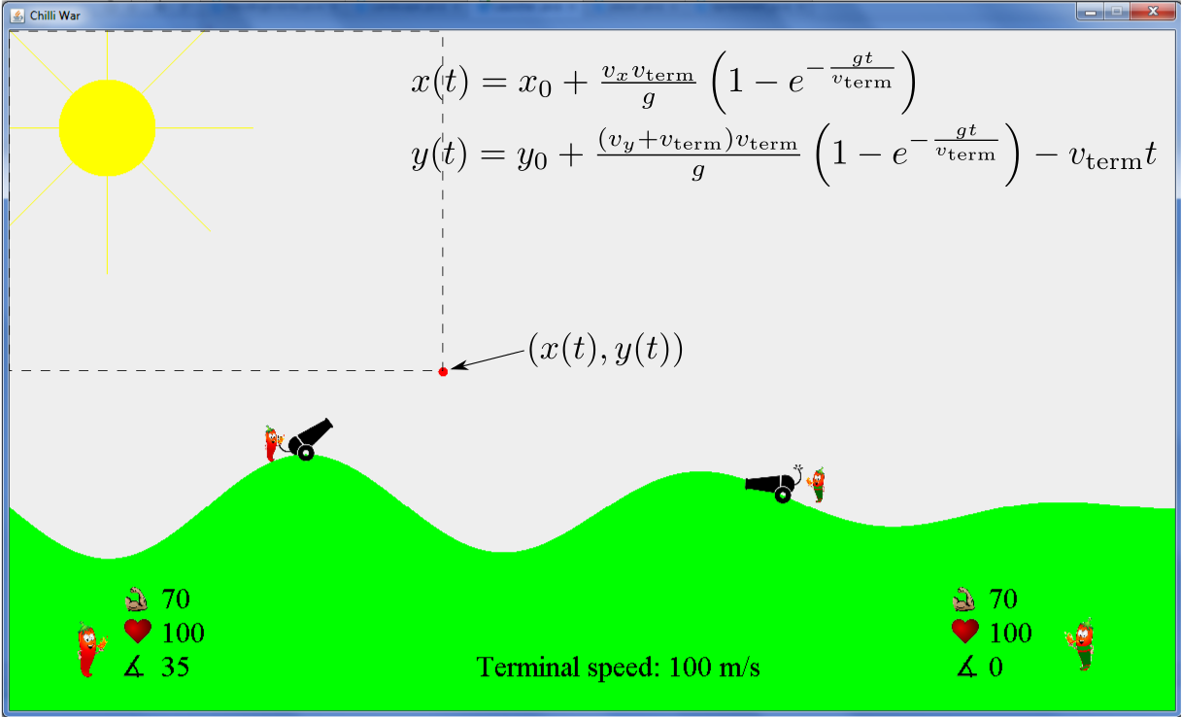
Calculate the coordinates of the ball

Slide 6
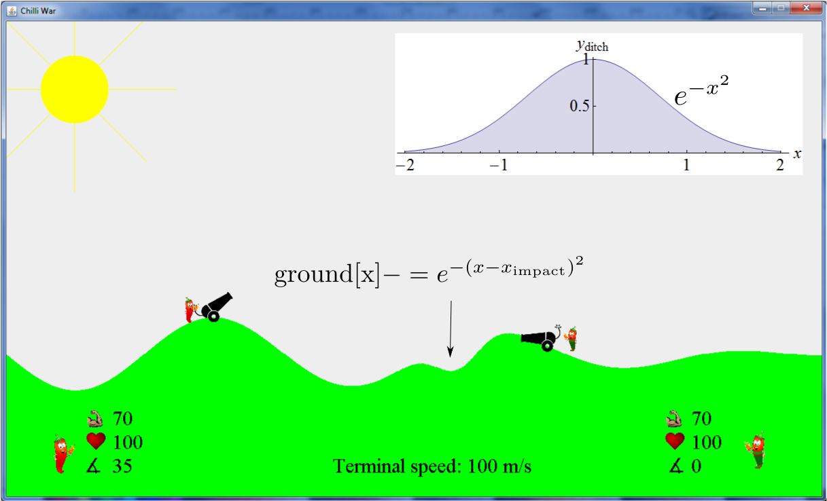
Ditch upon impact

Slide 7
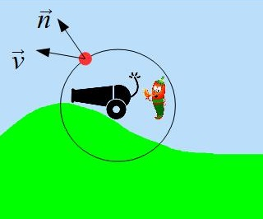
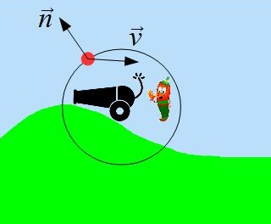


Check whether any player is hit
If $\vec{n}∙\vec{v}>0$, the player is not hit
If $\vec{n}∙\vec{v}<0$, the player is hit

Slide 8
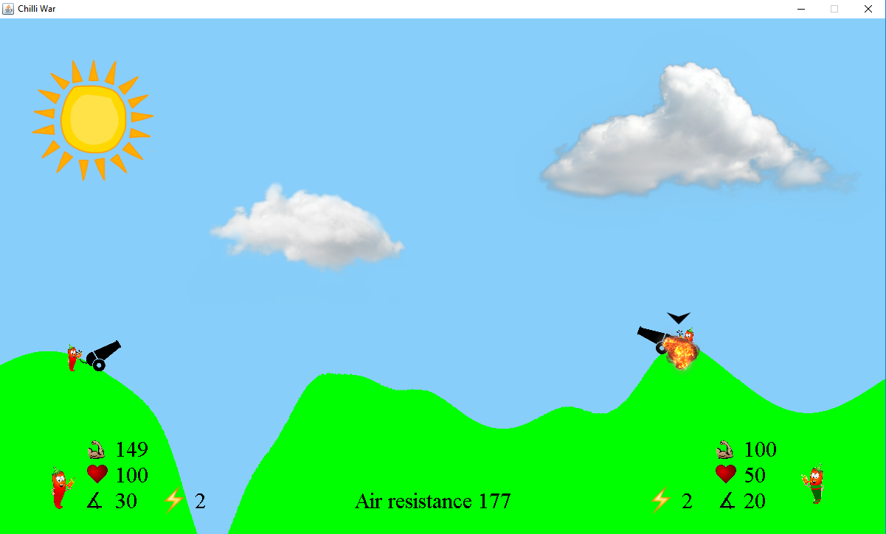
Fancy animations -- explosion

Slide 9
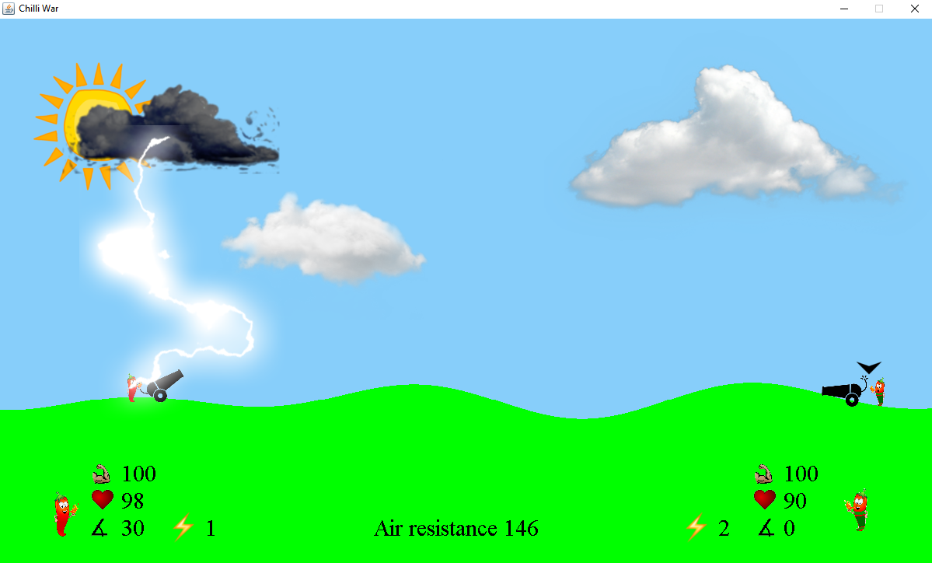
Fancy animations – thunder strike

